Slide 1
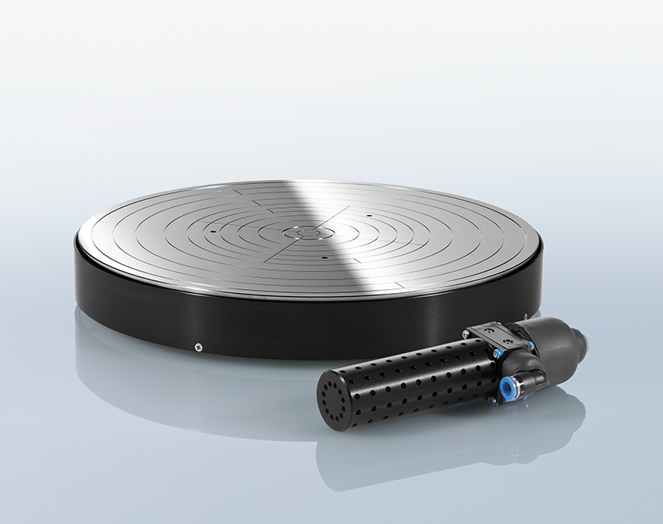

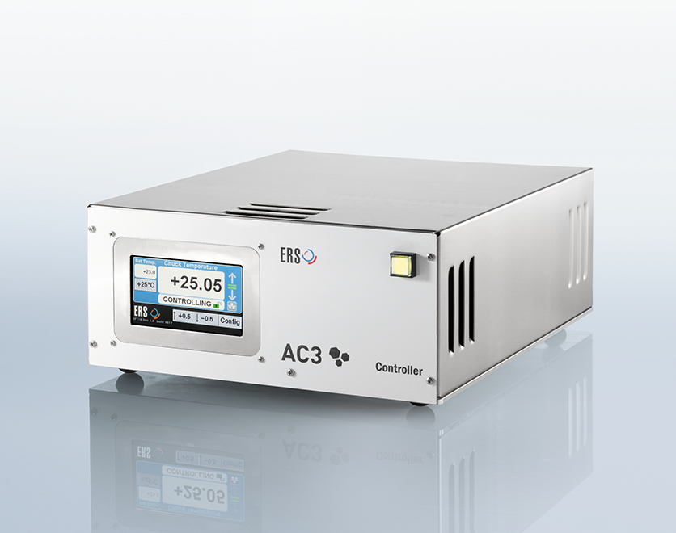
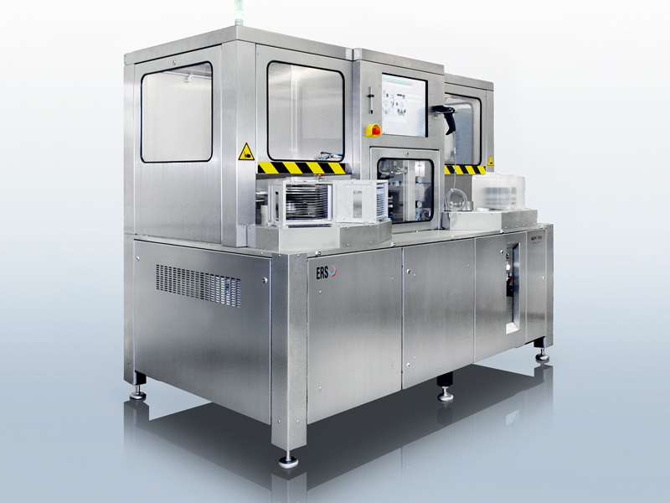
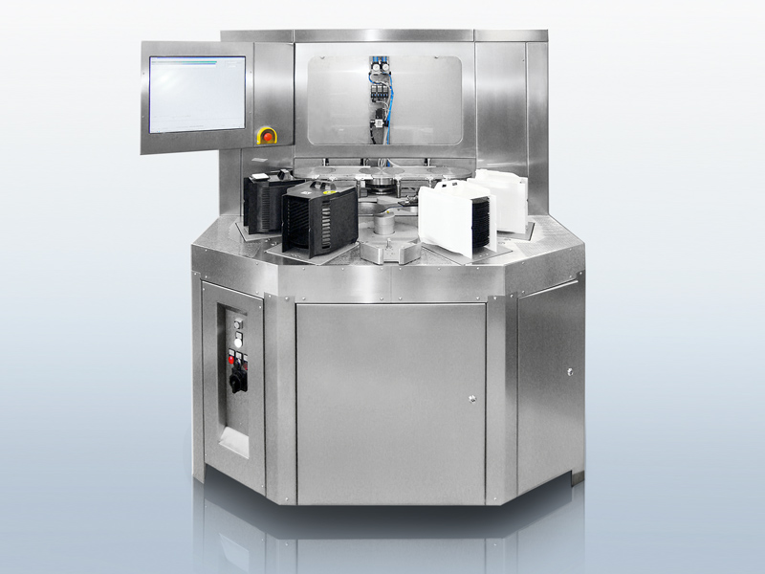
Innovation is in our lifeblood

Slide 2

Endtest Analysis and Reccomendations
By Austin Ibele

Slide 3
Agenda
Methods
Limitations
Process flow
Overview of Recommendations
Detailed Recommendations

Slide 4
Methods
1st: General interviews
2nd: Review of all test documentation (Chiller, Controller, Endtest, etc)
3rd /4th : Asking specific questions/Observation/Understanding tests
3rd /4th : Root Cause Analysis of Quality Complaints
Conclusion: Lets save time and make it more difficult to make mistakes

Slide 5
Limitations
Scarce process performance data makes root cause analysis and optimization difficult
Large reduction in Endtest difficult since products must be tested as system
We will always have manual steps that are prone to error

Slide 6
Types of Quality Problems
Coming soon…
Notes:
Need to finish doing this..

Slide 7
Endtest Process Flow
Chuck from Chuck Department
Fi
Controller from Cont. Department
Heating/Cooling
Curves & Temperature
Uniformity
Final Planarity testing at Chuck Department
Noise Testing
Steps
Chiller from Chiller Department
Temp Display/PT100 Calibration
Shipping
Packing

Slide 8
Overview of Reccomendations
Documentation
Collect Data
Document Processes
Verify Packing-lists and enter into SAGE
Tablet for mobile data-entry
Optimization
End duplicate temperature display calibration
Electric screwdriver
New temperature uniformity protocol to reduce human error
Modify steps protocol
Automation
“Doc Generator V2”/XLS data validation
Automate temperature uniformity and heating/cooling curves
Label printer
Automate temperature display calibration
Programmatically find steps abnormalities
Process Change
New controllers for Chuck department and more intensive testing
Final visual check/signoff
Separate person for packing/shipping/system inspection

Slide 9
Documentation-Related Suggestions

Slide 10

Collect Data
What:
Collect process performance data
How:
Document all defects discovered in Endtest as well as corrections
Save all test data, including data that does not meet product specifications
Create form for written data-collection
Create database/spreadsheet to store it
Why:
Aid Root Cause Analysis
Aid process optimization
Assess process changes
How Much/Other:
0 EUR capital investment
Can implement immediately
Minimal time to implement, minimal increase in Endtest work

Slide 11
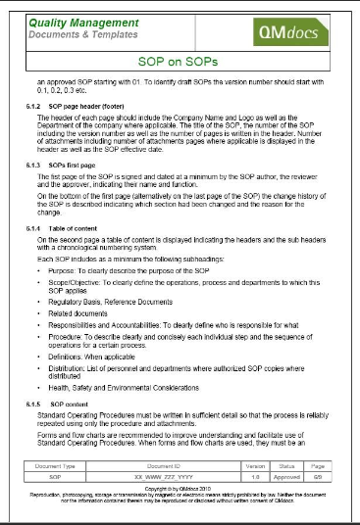
Document Process
What:
Create documentation describing Endtest
How:
Record process steps
Create procedures documents
May learn/assist with tests to help with documenting steps
Why:
So other workers can perform Endtest duties
Aid others in understanding/analyzing process
How Much/Other:
0 EUR capital investment
Moderate time investment
Finish by end of May, 2019

Slide 12
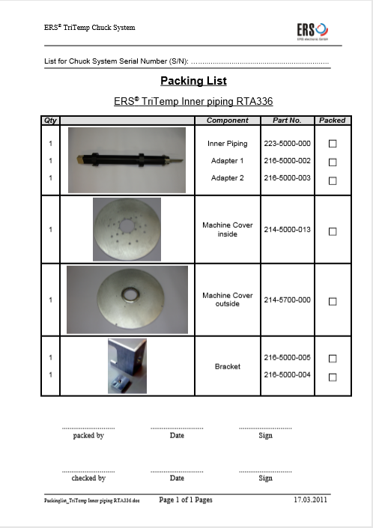
Verify Packing-lists and enter into SAGE
What:
Verify Accuracy of Packing-Lists
Attach Packing-Lists to systems in SAGE
How:
Have „systems experts“ (z.b. Matthias) check accuracy of existing packing-lists
Have someone add each packing-list to corresponding system in SAGE
Why:
Many complaints about missing/wrong parts
Root cause is often incorrect or incomplete packing-lists
How Much/Other:
0 EUR capital investment
Moderate time investment
Unknown time to complete?

Slide 13

Tablet for mobile data-entry
What:
Use tablet/hand-held computer to enter all data for Endtest documents
How:
Create data-collection forms with data-validation
Enter test results/other information into tablet
Likely windows tablet for use with server (Need to research..)
Why:
Written results sometimes out of spec
Difficult to read
Errors when performing „mental math“
Doesn‘t look as good
How Much/Other:
200-300 EUR capital investment/tablet
Moderate time investment
Possible to finish by end May, 2019
Notes:
https://www.amazon.com/Windows-Fusion5-Ultra-Design-Tablet/dp/B00YCX7SGU/ref=sr_1_3?keywords=windows+10+tablet&qid=1552466918&s=electronics&sr=1-3

Slide 14
Optimization-Related Suggestions

Slide 15
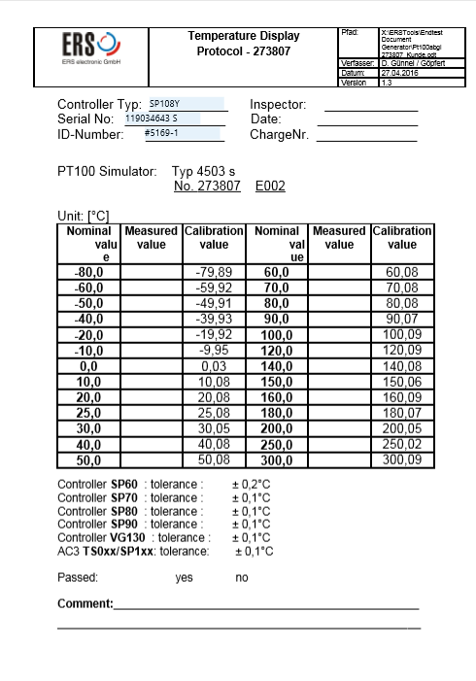
End duplicate temperature display calibration
What:
Stop performing display calibration protocol twice
How:
Make controller/chiller department keep performing calibration and verify in-spec
Have Endtest stop performing this test
Why:
This test is performed twice for no good reason (once in chiller/controller
department, again in Endtest)
If controller/chiller department measures out-of-spec, they leave it out-of-spec
for Endtest to fix
How Much/Other:
0 EUR capital investment
Can implement immediately
Will require more time for Chiller/Controller department
Will save a greater amount oftime in Endtest

Slide 16
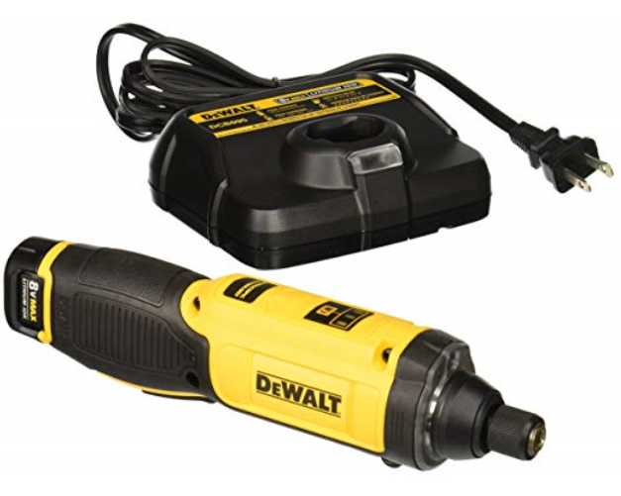
Electric Screwdriver
What:
Electric screwdriver to save time
How:
Equip departments with electric screwdrivers
Many models exist, suitable for small electronics to large machines
Why:
Dissamebly/assembly often required to fix/trouble-shoot in Endtest
Almost all departments spend a significant time using screwdrivers
How Much/Other:
30-100 EUR capital investment/screwdriver
Can implement immediately
Minimal time to implement

Slide 17
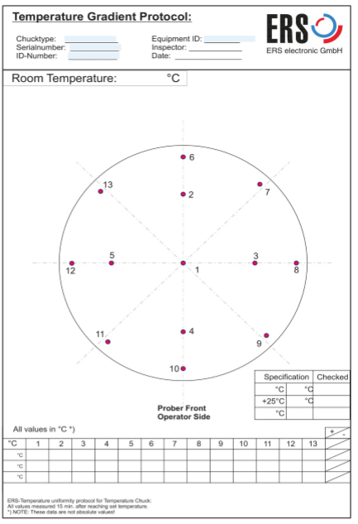
New temperature uniformity protocol to reduce human error
What:
Reduce hand-written errors on documents
How:
Increase size of spaces for writing
New/modified document
Why:
Handwriting sometimes difficult to read
Out-of-spec numbers not noticed
How Much/Other:
0 EUR capital investment
A few hours time investment
Can implement < 4 weeks

Slide 18
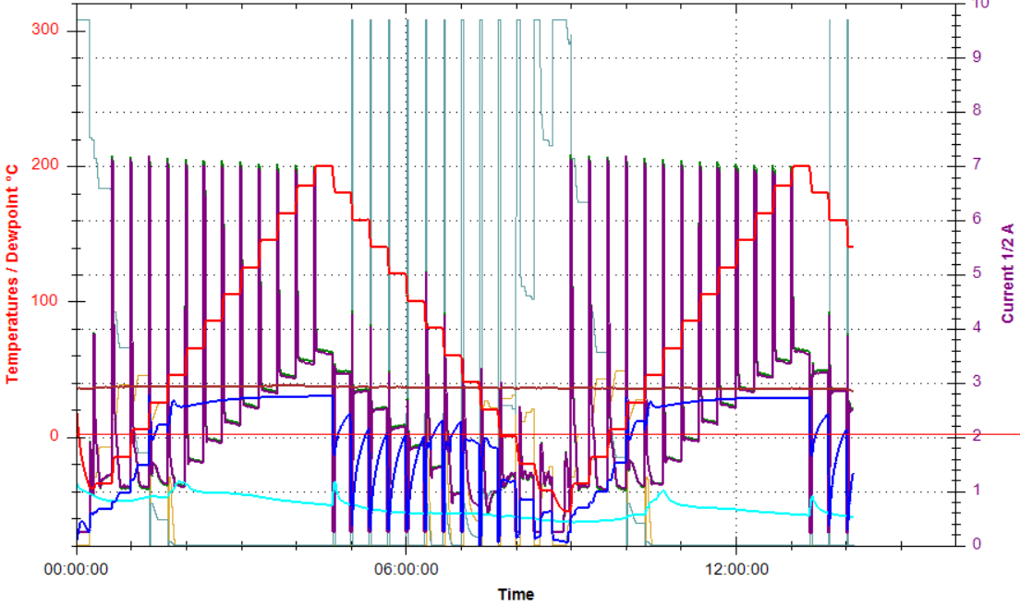
Modify Steps Protocol
What:
Save time OR
Increase sensitivity of test
How:
Reanalyze all recent steps
Begin saving data on failed steps for analysis
Document when steps fail
Maybe change step intervals/duration to save time/increase accuracy
Why:
Steps are arbitarily defined
Not data-based, so possible room for improvement
How Much/Other:
0 EUR capital investment
Need to wait for sufficient data to implement
Implementation in > 3 months?

Slide 19
Automation-Related Suggestions

Slide 20
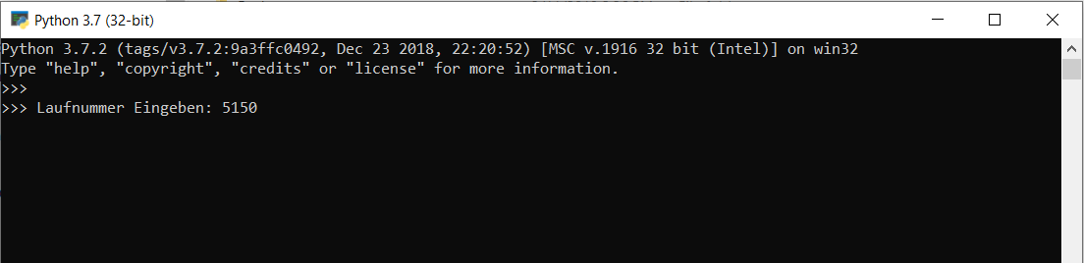
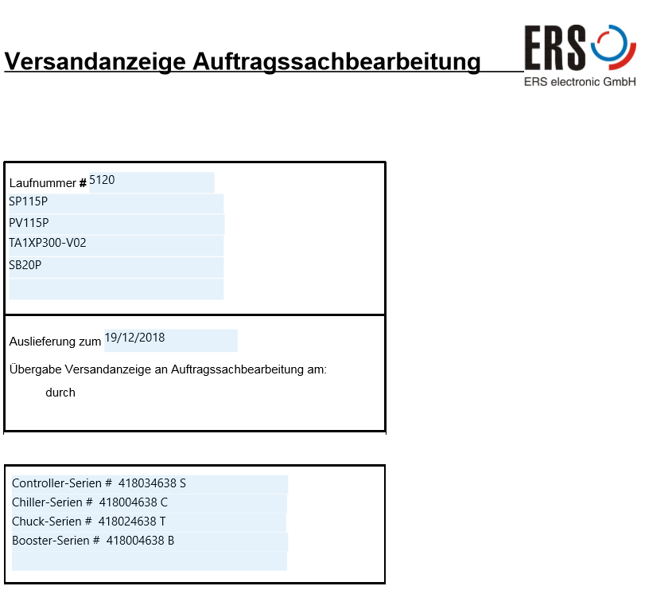
”Doc Generator V2”/XLS data validation
What:
Further improve accuracy/time savings of „Endtest Document Generator“ tool
How:
Merge many PDFs into a single document for eaiser printing
Create macros in „Seriennummern“ spreadsheet to prevent entry of wrong information
Pipe data from Auftragsliste to Seriennummern XLS
Why:
Opening and printing all different documents still time consuming
Errors in Doc Generator output result from Seriennummern XLS input errors
Easy to accidently make input error into Seriennummern XLS
How Much/Other:
0 EUR capital investment
Moderate time to implement
Can implement in < 4 weeks

Slide 21
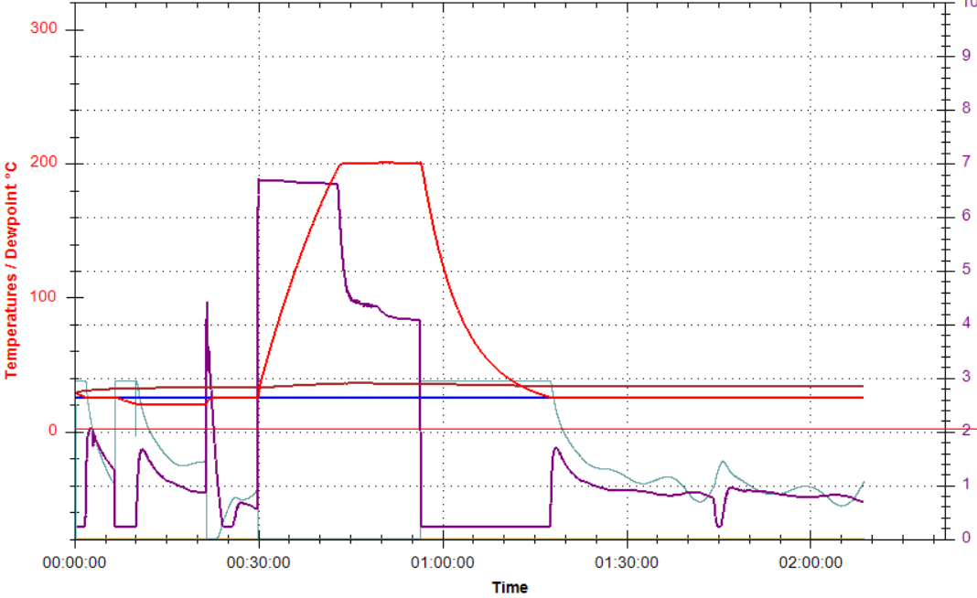
Automate temperature uniformity and heating/cooling curves
What:
Automate determination of heating/cooling time and uniformity profile
How:
Paddy will create new option in software to run heating/cooling and
steps together
Sensarray Wafer will collect data overnight while running tests
New computer program will analyze Sensarray data and determine
heating/cooling time and temperature uniformity
Why:
Temperature uniformity performed during heating/cooling curves
Time consuming process
How Much/Other:
0 EUR capital investment
Can implement immediately
Minimal time to implement, minimal increase in Endtest work

Slide 22
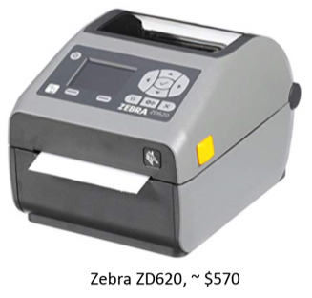
Label Printer
What:
Accurately make labels with a label printer
How:
Print serial number labels from serial number in seriennummern spreadsheet OR
Require double entry of serial number
Print on high temperature labels with programmable thermal transfer printer
Why:
Incorrect serial number on label is a common quality problem
Save time by eliminating the tedious task of manually making labels
How Much/Other:
~500 EUR capital investment/printer
? EUR for new custom labels
Moderate-Large time investment
Finish by end May 2019

Slide 23
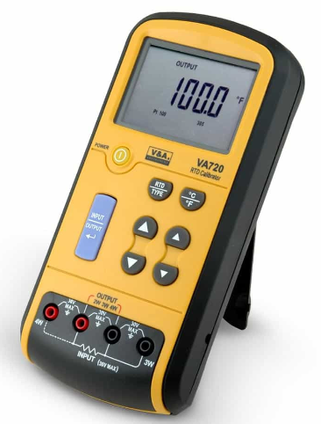
Automate Temperature Display Calibration
What:
Create new test program to guide/perform PT100 calibration protocol
How:
Program records display values
Adjusts calibration curve by comparing to simulation data
Test data goes into document (no more handwriting)
Must be done by Paddy
Why:
Time consuming (10 – 30 minutes depending on results)
Some quality complaints on out-of-spec results written
How Much/Other:
0 EUR capital investment
High time investment/High Reward
Defer to Paddy, who is the expert

Slide 24
Programmatically find steps abnormalities
What:
Identify system controlling problems (from steps data) automatically
How:
Write program to analyze steps data and look for evidence of controlling problem
Can be a separate program ran after the AC3 test program OR
Integrated into AC3 test program by Paddy
Why:
Possibly more accurate than humans (humans are great at pattern recognition
, but can be distracted)
Save time since graph no longer needs to be looked at closely
Assess process changes
How Much/Other:
0 EUR capital investment
Unsure how accurate it would be, but confident and think it could be worth trying
Best if integrated into AC3 test program

Slide 25
Process Change-Related Suggestions

Slide 26
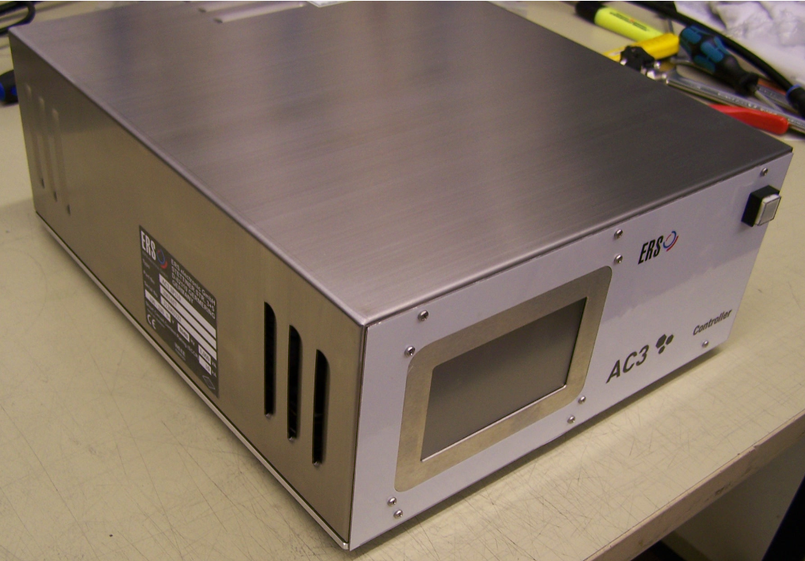
New controllers for Chuck department and more intensive testing
What:
Find controlling problems earlier with new controllers and different tests in Chuck Department
How:
New controllers (z.b. SP110) for chuck department
Computer for chuck department to run AC3 test software
Replace uberschwing test with heating to 50C, 80C and
controlling (reccomended by Paddy)
*MAYBE CAN ALSO write program to find controlling errors and use with current SP72
Why:
Endtest catches PT100 placement/controlling problems that Uberschwing test misses
These problems often not noticed until steps test, which is performed almost last
Currently using SP72 controller with only a LED readout of temperature
How Much/Other:
Unknown (?) capital investment
No/minimal increase in work for Chuck Department
Chuck Department unhappy with current controllers and wants new ones
Extremely easy to implement once you have new controllers/computers
SP110 Controller

Slide 27
Final Visual Check/Sign-off
What:
Have another employee visually inspect/sign-off on system
How:
Add to duties of upstairs/Lager worker (better if they are disconnected from production process)
Perform after testing and prior to packaging
Why:
Loose screws, cosmetic problems, incorrect serial numbers are common problems
How Much/Other:
0 EUR capital investment
Can implement immediately
No change to work of Endtest worker
~2-3 hours per week duty for upstairs worker

Slide 28
Separate person for preparation/packing/shipping
What:
Similar to previous reccomendation but with additional duties
How:
Another employee focuses on preparation of materials, visual inspection, packing, shipping
Separate from test duties of Nuhan
Why:
Nuhan is the expert in test, so he should test
Nuhan over-worked on shipping days
Distracted from testing by additional duties
How Much/Other:
Large investment if new hire
Possibly combine this position with Pierre‘s old position?

Slide 29

Contact us
Interested in learning more? Contact us:
E-Mail: info@ers-gmbh.de
Web site: www.ers-gmbh.com
Telephone: +49 8989 4132-0
Follow us on social media:
Twitter: @ers_gmbh
LinkedIn: https://de.linkedin.com/company/ers-electronic-gmbh
Press contact: Miguel Resendiz
E-Mail: m.resendiz@ers-gmbh.de
Telephone/Mobile: +49 8989 4132-143

Slide 30

Thank You

